Slide 1
Theory of Automata and Formal Language
Lecture-31
Dharmendra Kumar
(Associate Professor)
Department of Computer Science and Engineering United College of Engineering and Research, Prayagraj March 30, 2021

Slide 2
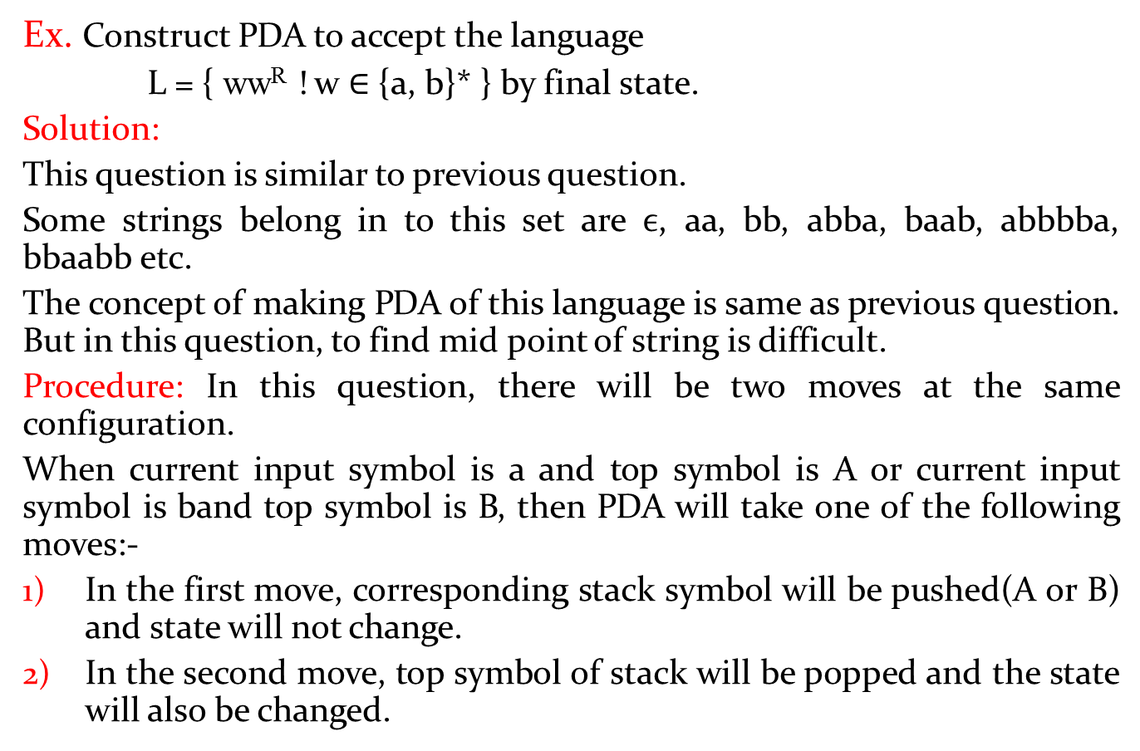
PDA examples continue
Ex.Construct PDA to accept the language
L = { ww^{R}! w ∈ {a, b}* } by final state.
Solution:
This question is similar to previous question.
Some strings belong in to this set are $ϵ$, aa, bb, abba, baab, abbbba, bbaabbetc.
The concept of making PDA of this language is same as previous question. But in this question, to find mid point of string is difficult.
Procedure: In this question, there will be two moves at the same configuration.
When current input symbol is a and top symbol is Aor current input symbol is band top symbol is B, then PDA will take one of the following moves:-
In the first move, corresponding stack symbol will be pushed(A or B) and state will not change.
In the second move, top symbol of stack will be popped and the state will also be changed.

Slide 3

Ex. L={ ww^{R} ! w ∈ {a, b}* } continue
Therefor e the PDA corresponding to above language is constructed as following:-
M = ({q_{0,} q_{1,} q₂ }, {a, b}, {A, B, Z₀ }, δ, q₀,Z_{0,} {q₂})
δ is defined as following:-
δ(q₀, a, Z₀) = {(q₀, AZ₀ )} δ(q₀, b, Z₀) = {(q₀, BZ₀ )} δ(q₀, a, A) = {(q₀, AA ), (q₁, $ϵ$)} δ(q₀, a, B) = {(q₀, AB )}
δ(q₀, b, B) = {(q₀, BB ), (q₁, $ϵ$)}δ(q₀, b, A) = {(q₀, BA )}
δ(q₀, $ϵ$, Z₀) = {(q₁, Z₀ )}δ(q₁, a, A) = {(q₁, $ϵ$ )}δ(q₁, b, B) = {(q₁, $ϵ$)} δ(q₁, $ϵ$, Z₀) = {(q₂, Z₀)}

Slide 4

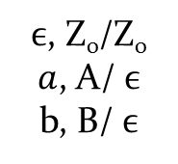

Ex. L={ ww^{R} ! w ∈ {a, b}* } continue
Transition diagram of PDA is the following:-
a, A/$ϵ$
b, B/$ϵ$
a, Z₀/AZ₀
a, A/AA
a, B/AB
b, Z₀/BZ₀
b, A/BA
b, B/BB
q₀
q₁
q₂
$ϵ$, Z₀/Z₀
$a$, A/$ϵ$
b, B/$ϵ$
$ϵ$, Z₀/Z₀

Slide 5
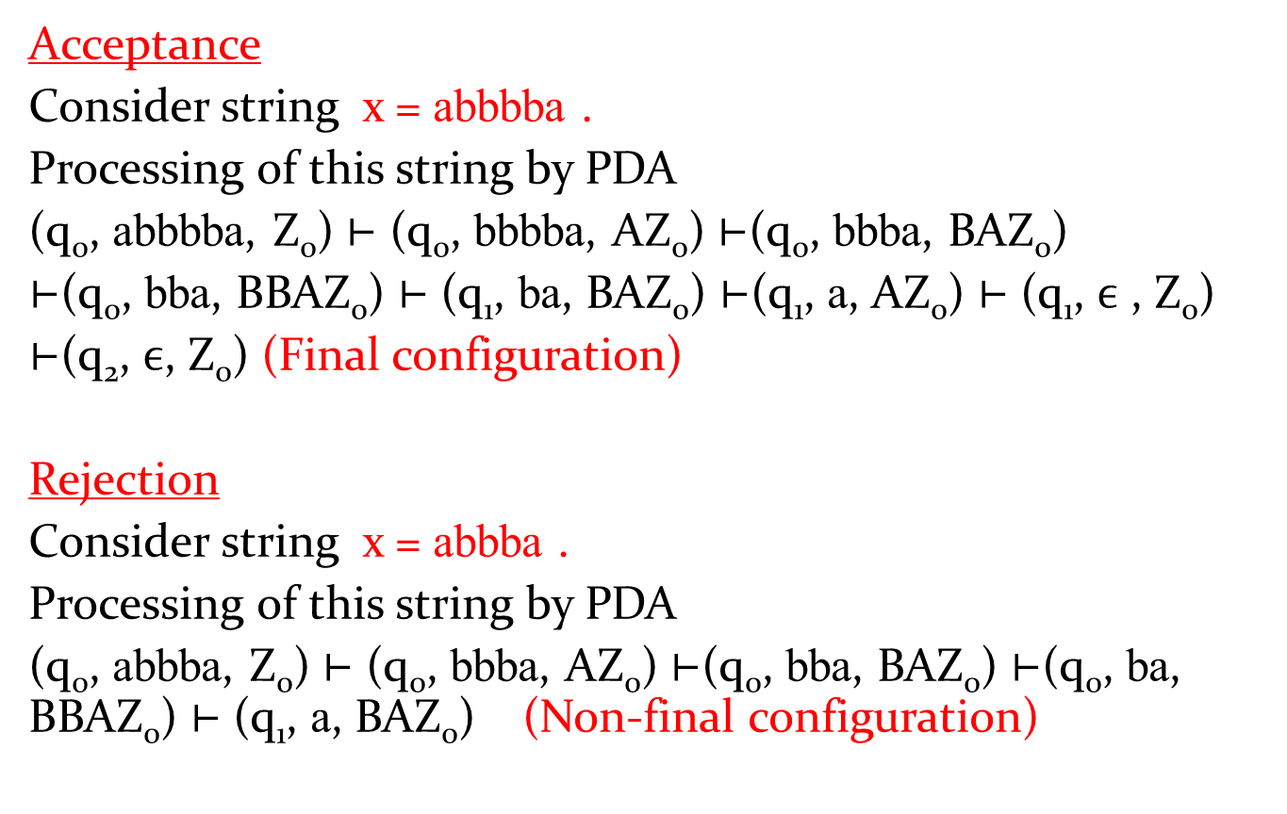
Processing and Verification of above PDA
Acceptance
Consider string x = abbbba.
Processing of this string by PDA
(q₀, abbbba, Z₀) ⊢ (q₀, bbbba, AZ₀) ⊢(q₀, bbba, BAZ₀)
⊢(q₀, bba, BBAZ₀) ⊢ (q₁, ba, BAZ₀) ⊢(q₁, a, AZ₀) ⊢ (q₁,$ϵ$ , Z₀)
⊢(q₂, $ϵ$, Z₀) (Final configuration)
Rejection
Consider string x = abbba.
Processing of this string by PDA
(q₀, abbba, Z₀) ⊢ (q₀, bbba, AZ₀) ⊢(q₀, bba, BAZ₀) ⊢(q₀, ba, BBAZ₀) ⊢ (q₁, a, BAZ₀) (Non-final configuration)

Slide 6
Some questions
Construct PDA to accept the following languages:-
L = { a^{n} b^{2n} ! n ≥ 1 }
L = { a^{n} b^{3n} ! n ≥ 1 }
L = { a^{m} b^{n} c^{n} d^{m} ! m, n ≥ 1 }
L = { a^{n} b^{m} c^{n} ! m, n ≥ 1 }
L = {a^{i} b^{j} c^{k} ! i = j or j = k}

Slide 7
Ex. Construct PDA to accept the language
L = { a^{n} b^{2n} ! n ≥ 1 } by empty stack.
Solution:
In this question, number of b is two times of number of a. Therefore, the PDA should read two b corresponding to one a.
In this question, when a appears in input string, then push the stack symbol A in to the stack.
When b appears in input string, then machine change its state. When second b appears input string, then we change sate and pop the top symbol of stack.
In this question, PDA will pop a top symbol from stack when bb(i.e two b) appears in the input string.

Slide 8

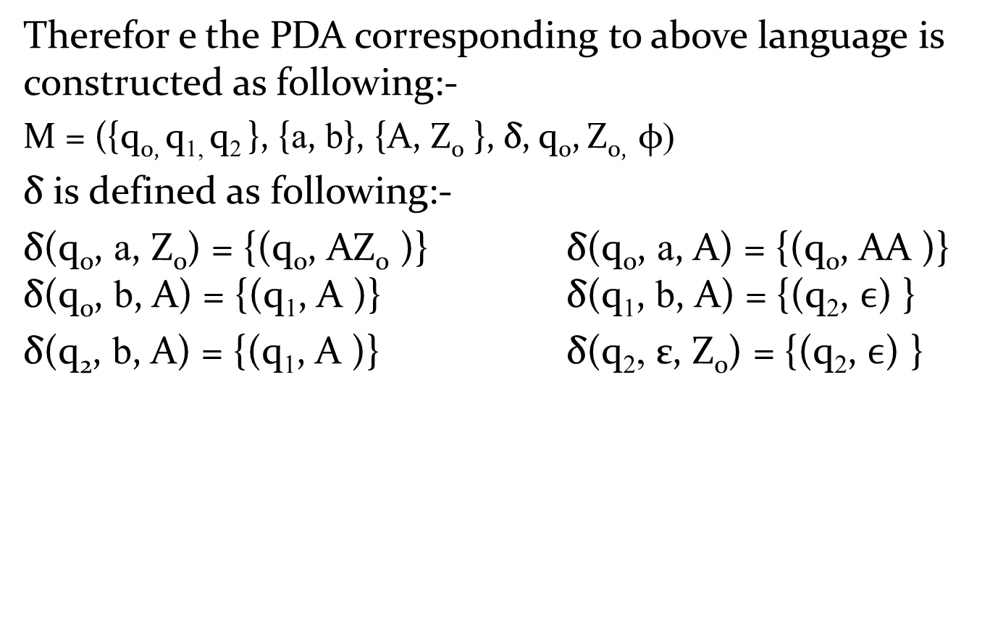



L = { a^{n} b^{2n} ! n ≥ 1 }
Therefor e the PDA corresponding to above language is constructed as following:-
M = ({q_{0,} q_{1,} q₂}, {a, b}, {A, Z₀ }, δ, q₀,Z_{0,} φ)
δis defined as following:-
δ(q₀, a, Z₀) = {(q₀, AZ₀ )} δ(q₀, a, A) = {(q₀, AA )} δ(q₀, b, A) = {(q₁, A )}δ(q₁, b, A) = {(q₂, $ϵ$) }
δ(q₂, b, A) = {(q₁, A )}δ(q₂, ε, Z₀) = {(q₂, $ϵ$) }
$ϵ$, Z₀ /$ϵ$
a, Z₀/AZ₀
a, A/AA
b, A/$A$
q₀
q₁
q₂
b, A/$A$
$b$,A/$ϵ$

Slide 9
Ex. Construct PDA to accept the language
L = { a^{m} b^{n} c^{n} d^{m} ! m, n ≥ 1 } by empty stack.
Soultion:
Some strings belong in to this set are abcd, abbccd, aabcdd, aaabbccddd etc.
In this language, number of a and d are equal and number of b and c are equal.
Therefore, we have to push stack symbol corresponding to a and pop that stack symbol corresponding to d.
Similarly, we have to push another stack symbol corresponding to b and pop that stack symbol corresponding to c.
To preserve the order of a, b, c and d, machine changes its state when move from a to b, b to c, and c to d.

Slide 10

Therefor e the PDA corresponding to above language is constructed as following:-
M = ({q_{0,} q_{1,}q_{2,} q₃}, {a, b, c, d}, {A, B, Z₀ }, δ, q₀,Z_{0,} φ )
δ is defined as following:-
δ(q₀, a, Z₀) = {(q₀, AZ₀ )} δ(q₀, a, A) = {(q₀, AA )}δ(q₀, b, A) = {(q₁, BA )}δ(q₁, b, B) = {(q₁, BB ) }
δ(q₁, c, B) = {(q₂, $ϵ$ )}δ(q₂, c, B) = {(q₂, $ϵ$ )}
δ(q₂, d, A) = {(q₃, $ϵ$ )}δ(q₃, d, A) = {(q₃, $ϵ$)}
δ(q₃, $ϵ$, Z₀) = {(q₃, $ϵ$ )}

Slide 11

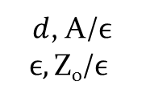




L = { a^{m}b^{n} c^{n}d^{m} ! m, n ≥ 1 }
Transition diagram of PDA is the following:-
b, B/$BB$
a, Z₀/AZ₀
a, A/AA
$c$, B/$ϵ$
$d$, A/$ϵ$
$$ϵ,\text{Z}\text{0}\text{/}ϵ$$
q₀
q₁
q₂
q₃
$b$, A/BA
$c$, B/$ϵ$
$d$, A/$ϵ$

Slide 12
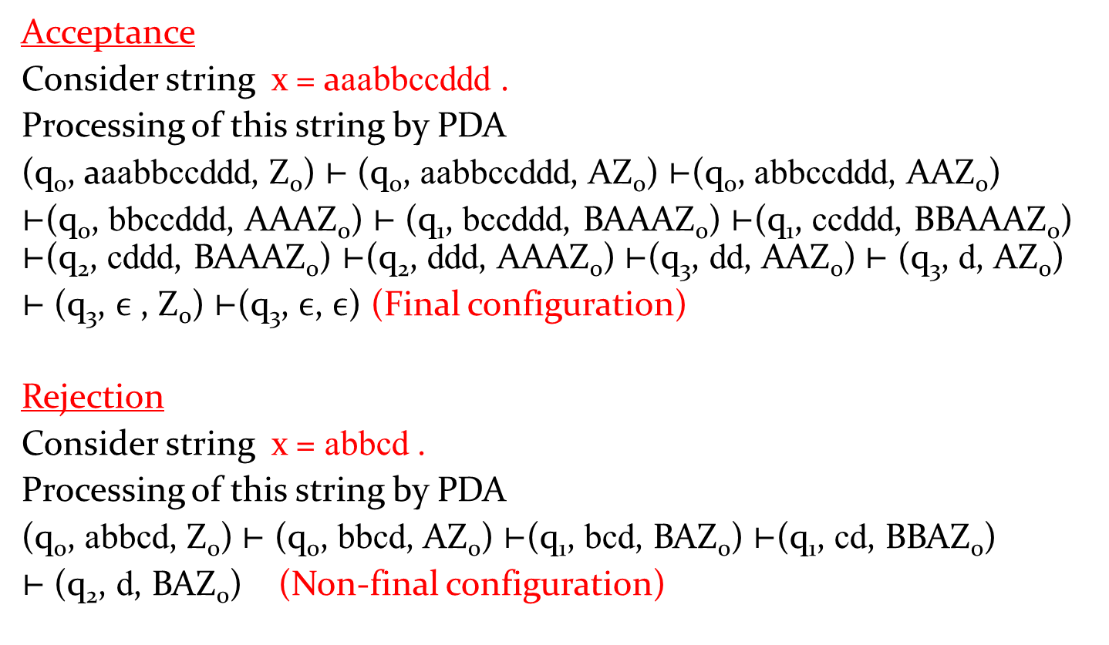
Processing and Verification of above PDA
Acceptance
Consider string x = aaabbccddd.
Processing of this string by PDA
(q₀, aaabbccddd, Z₀) ⊢ (q₀, aabbccddd, AZ₀) ⊢(q₀, abbccddd, AAZ₀)
⊢(q₀, bbccddd, AAAZ₀) ⊢ (q₁, bccddd, BAAAZ₀) ⊢(q₁, ccddd, BBAAAZ₀) ⊢(q₂, cddd, BAAAZ₀)⊢(q₂, ddd, AAAZ₀) ⊢(q₃, dd, AAZ₀) ⊢ (q₃, d, AZ₀)
⊢ (q₃,$ϵ$ , Z₀) ⊢(q₃, $ϵ$, $ϵ$) (Final configuration)
Rejection
Consider string x = abbcd.
Processing of this string by PDA
(q₀, abbcd, Z₀) ⊢ (q₀, bbcd, AZ₀) ⊢(q₁, bcd, BAZ₀) ⊢(q₁, cd, BBAZ₀)
⊢ (q₂, d, BAZ₀) (Non-final configuration)

Slide 13




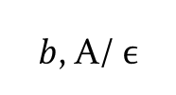






Ex. L = {a^{i} b^{j} c^{k} ! i = j or j = k}
The PDA corresponding to this language is the following:-
$ϵ$,Z₀/$\text{Z}\text{0}$
b, A/$ϵ$
a, Z₀/AZ₀
a, A/AA
a, Z₀/Z₀
$c$,Z₀/$\text{Z}\text{0}$
q₀
$b$, A/$ϵ$
q₁
$c$,Z₀/$\text{Z}\text{0}$
q₂
$ϵ$,Z₀/$\text{Z}\text{0}$
q₃
$b$, B/$BB$
$c$, B/$ϵ$
$b$,Z₀/B$\text{Z}\text{0}$
q₄
q₅
$ϵ$,Z₀/$\text{Z}\text{0}$
$c$, B/$ϵ$

